Slide 1
SARS-CoV-2 Classification on Real Patients CT Scan Using Attention Masked DenseNet
Team20
Zehao Zhu, 51808153
Yuehao Wang, 79267084

Slide 2
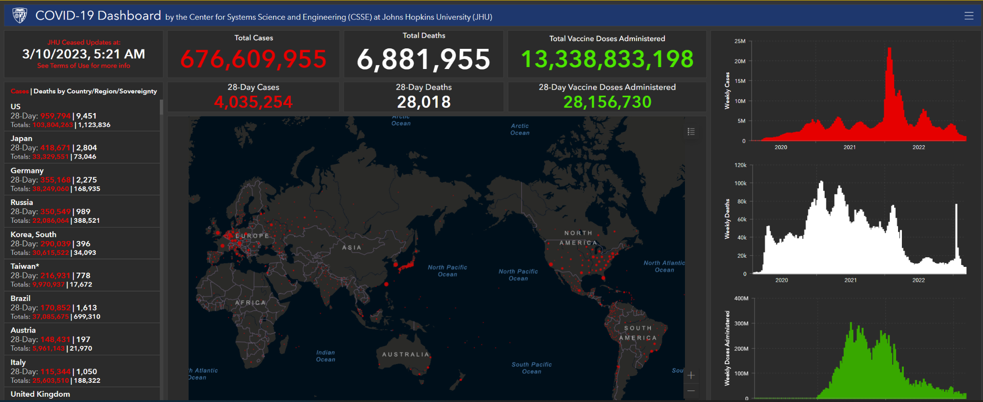
Background
SARS-Cov-2 spreads worldwide with over 6 million deaths and over 676 million cases in more than 210 countries by 2023. It has become a global health emergency that causes huge pressure on governments.
SARS-CoV-2 has evolved from an emergency to a long-term global health issue. This persistent challenge highlights the need for continued research and advanced diagnostic solutions, like our AI-driven approach, to effectively manage and understand the evolving situation.
Figure 1 Statistics of COVID-19 from JHU
https://coronavirus.jhu.edu/map.html

Slide 3
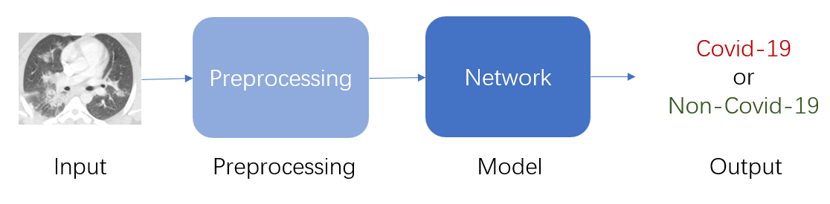
Task
As a matter of fact, AI models become increasingly significant in clinical practice and have the potential in image-based medical diagnoses . Hence, Our task focuses on using the AI model in clinical practice, particularly for image-based medical diagnoses. Our objective is to create a network that can accurately distinguish between COVID-19 and non-COVID-19 cases in CT scans through binary classification. Achieving this would establish our model as a valuable tool for aiding diagnosis.

Slide 4
Related Works
SARS-CoV-2 Classification:
Deep learning with medical images has been widely used in diagnosis but the accuracy of SARS-CoV-2 is relatively low. Panwar et al. [1] demonstrate a classification with colored visualization on infected areas with an accuracy of 95.61%. Singh et al. [2] modeled a multi-objective differential evolution-based convolutional neural network to have a better classification accuracy of 93.20%. CTnet-10 [3] based on Convolutional Neural Networks is also introduced with 82.10% accuracy. Our method should reach a higher accuracy with visualization of interpretations.
[1] Panwar, H., Gupta, P. K., Siddiqui, M. K., Morales-Menendez, R., Bhardwaj, P., & Singh, V. (2020). A
deep learning and grad-CAM based color visualization approach for fast detection of COVID-19 cases using
chest X-ray and CT-Scan images. Chaos, Solitons & Fractals, 140, 110190.
[2] Singh, D., Kumar, V., Vaishali, & Kaur, M. (2020). Classification of COVID-19 patients from chest CT
images using multi-objective differential evolution–based convolutional neural networks. European Journal of
Clinical Microbiology & Infectious Diseases, 39, 1379-1389.
[3] Shah V, Keniya R, Shridharani A, Punjabi M, Shah J, Mehendale N. Diagnosis of COVID-19 using CT scan images and deep learning techniques. Emerg Radiol. 2021 Jun;28(3):497-505. doi: 10.1007/s10140-020-01886-y. Epub 2021 Feb 1. PMID: 33523309; PMCID: PMC7848247.

Slide 5
Related Works
DenseNet:
The DenseNet is a convolutional neural network for many computer vision tasks, such as detection and classification. It uses Dense Blocks, containing cumulative residual-like layers, to extract more robust features connecting the former and latter layers. One significant advantage of the DenseNet is that it achieves high accuracy with fewer parameters.
Huang, G., Liu, Z., Van Der Maaten, L., & Weinberger, K. Q. (2017). Densely connected convolutional
networks. In Proceedings of the IEEE conference on computer vision and pattern recognition (pp. 4700-4708).

Slide 6
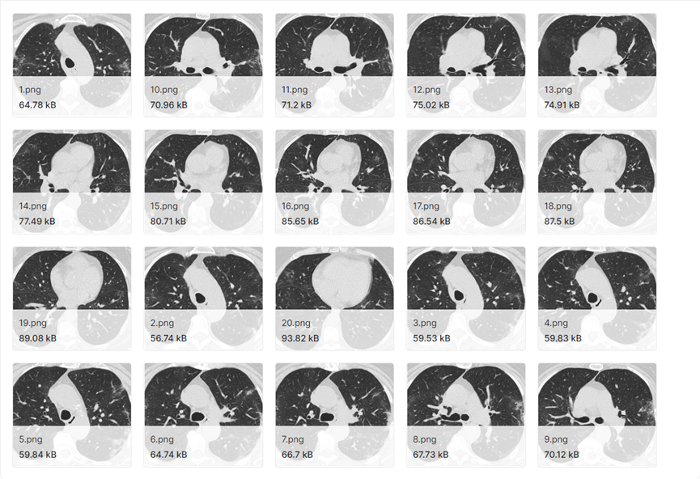
Dataset
The dataset contains 4173 CT scan images of many patients, shown in Figure 1, either having SARS-CoV-2 or not from the dataset created by Eduardo Soares and Plamen Angelov.
Figure 1 Dataset of CT scan
Soares, E., Angelov, P., Biaso, S., Froes, M. H., & Abe, D. K. (2020). SARS-CoV-2 CT-scan dataset: A large
dataset of real patients CT scans for SARS-CoV-2 identification. medRxiv.

Slide 7
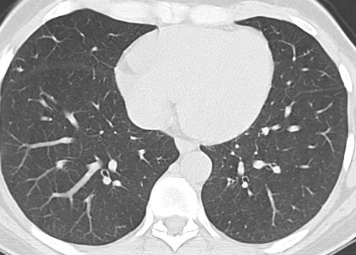
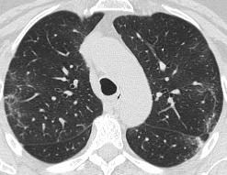
Samples
Non-Covid
Covid

Slide 8
Data Augmentation We Proposed
Resize the image to 224 x 225,
Randomly rotate the image from -20 degrees to 20 degrees,
Randomly affine translate from -0.2 proportion to 0.2 proportion,
Randomly horizontal flip
normalize with mean = [0.485, 0.456, 0.406] and sd = [0.229, 0.224, 0.225]
CT has a simpler structure and usually less deformed, shifted or rotated than X-ray. Thus, the range of values of augmentation should be small.

Slide 9
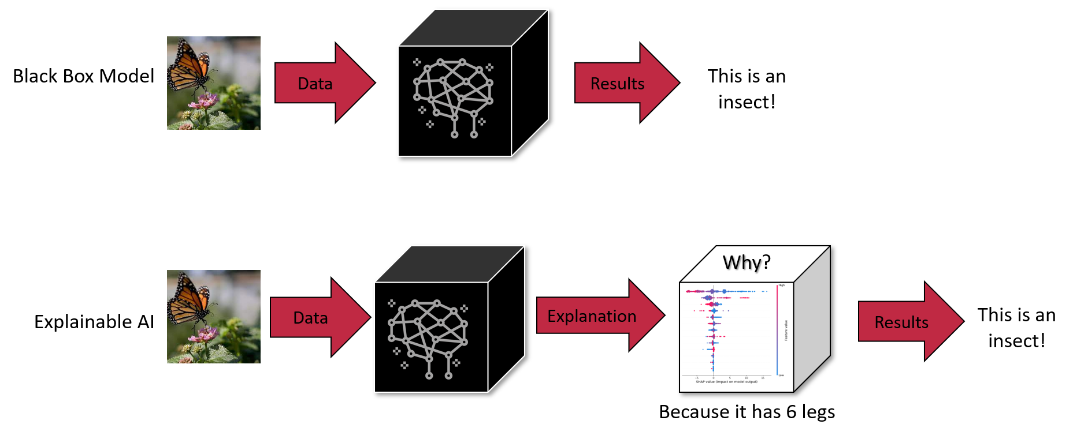
We want
to increase the accuracy
to make our model more explainable
https://www.advancinganalytics.co.uk/blog/2021/7/14/shap

Slide 10
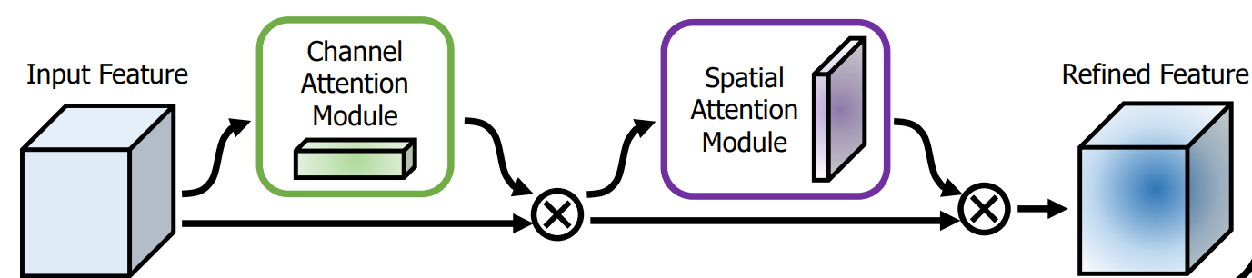
Attention Mask
We applied Convolutional Block Attention Mask on DenseNet201 which not only tells the model where to focus but also enhances the representation of interests. The attention mask contains two modules: channel attention and spatial attention.
These two modules work as two masks. We multiply them by the input features sequentially.
Woo, S., Park, J., Lee, J. Y., & Kweon, I. S. (2018). Cbam: Convolutional block attention module. In Proceedings of the European conference on computer vision (ECCV) (pp. 3-19).

Slide 11
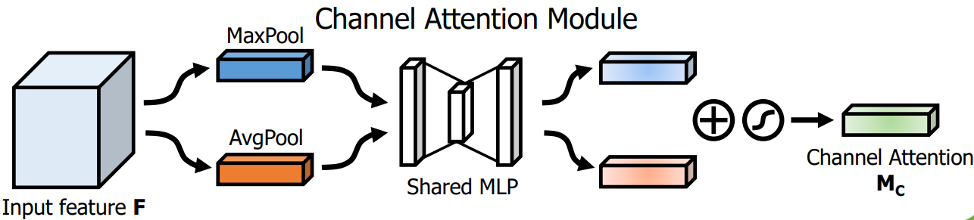
Channel Attention
Pooling: We first pass the input features into a parallel max and average pooling layer to extract single-value representation of each channel (shift invariance, and to reduce the dimensionality from BxCxHxW to BxCx1x1. B is batch size, C is the number of in-channels, H and W are height and width).
MLP: Then we downsample and upsample with two convolutional layers (in-features/ratio).
Output: Add them to calculate the sigmoid value on each channel.
(The sigmoid function here makes the model focuses on multiple channels because each channel computes the probability on itself.)
Woo, S., Park, J., Lee, J. Y., & Kweon, I. S. (2018). Cbam: Convolutional block attention module. In Proceedings of the European conference on computer vision (ECCV) (pp. 3-19).

Slide 12
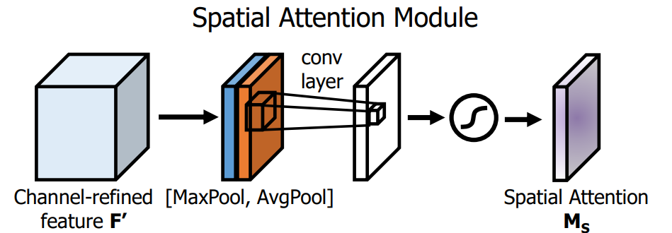
Spatial Attention
For spatial attention,
Pooling: after pooling on the channel dimension(from Bx1xHxW to Bx1xHxW), we concatenate the two pooled feature maps as a representation for each pixel.
Conv layer: Then we apply 7x7 convolutional layers (with paddings to keep the dimension of HxW but reduce the number of channels from two to one).
Output: Finally, the sigmoid function is used on each pixel and output the spatial attention mask.
Woo, S., Park, J., Lee, J. Y., & Kweon, I. S. (2018). Cbam: Convolutional block attention module. In Proceedings of the European conference on computer vision (ECCV) (pp. 3-19).

Slide 13
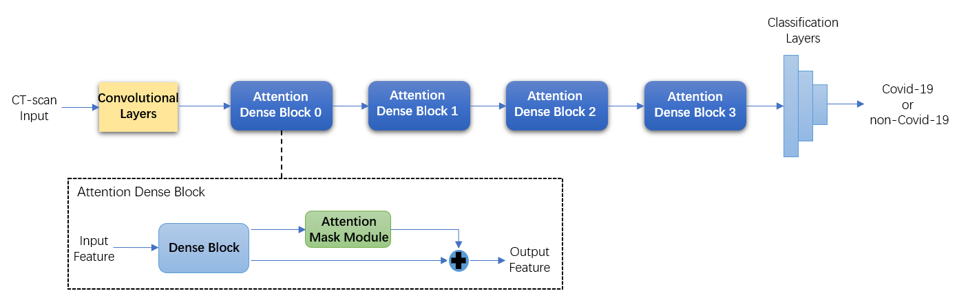
The Proposed Model
The proposed model is a combination of DenseNet201 and attention masks.
We applied the attention mask module directly after each dense block in a residual-like way. The new module is called attention dense block.
The network contains four attention dense blocks with final classification layers.
We use Cross Entropy loss as our loss function.

Slide 14
Experiments
To compare the performances between our model and other state-of-the-art models, we used accuracy as the metric. For fair comparisons, models were trained with AdamW optimizer in 50 epochs.
Model | Base Model | Acc (%)
CTnet-10 | CNN | 82.10%
Singh et.al | CNN | 93.20%
Panwar et.al (baseline) | VGG-19 | 95.61%
VGG-16 | x | 86.25%
ResNet50 | x | 91.01%
DenseNet201 | x | 93.13%
GoogLeNet | x | 92.56%
AttenDense(ours) | DenseNet201 | 97.84%
Our model surpassed the baseline 95.61% and achieved 97.84% accuracy.
It also outperformed other models, indicating that attention masks on DenseNet can help to increase accuracy on our task.
Loshchilov, I., & Hutter, F. (2017). Decoupled weight decay regularization. arXiv preprint arXiv:1711.05101.
Notes:
123

Slide 15
Experiments
We also conducted experiments to show the performance of using only channel-attention mask and only spatial-attention mask. An additional experiment with GoogLeNet showed that the proposed model has a better performance.
Model | Attention Mask | Acc (%)
Channel AttenDense | Channel attention mask | 95.56%
Spatial AttenDense | Spatial attention mask | 96.88%
GoogLeNet with Attention Mask | Channel and spatial attention masks | 97.36%
AttenDense(ours) | Channel and spatial attention masks | 97.84%
Combining the channel and spatial attention masks has higher accuracy. The spatial attention mask had the most significant enhancement because the CT scan relies more on the spatial information.

Slide 16
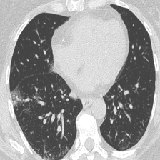
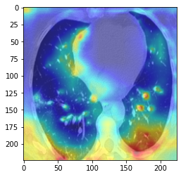
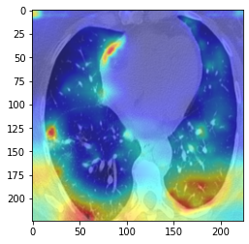
Explainable model
The input image with highlighting box (not in model training/evaluation)
The heat map of the model without attention masks.
The heat map of the model with attention masks.
We use Grad Cam to visualize regions that our model looks at. As we can see, after applying the attention mask, the model puts more attention on the shadow parts. This explains our model better and it is needed in the medical area.
Selvaraju, R. R., Cogswell, M., Das, A., Vedantam, R., Parikh, D., & Batra, D. (2017). Grad-cam: Visual explanations from deep networks via gradient-based localization. In Proceedings of the IEEE international conference on computer vision (pp. 618-626).

Slide 17
Conclusion
Our model, Attention Masked DenseNet, reaches 97.84% test accuracy on COVID-19 CT-scan detection with visualization of significant areas. It can help the diagnosis of COVID-19 as a decision helper to alleviate medical diagnosis pressure.

Slide 18
Thank you!

